Slide 1



Power bi final project
View in Power BI
Last data refresh:
5/5/2023 2:24:53 AM UTC
Downloaded at:
5/5/2023 2:26:25 AM UTC

Slide 2
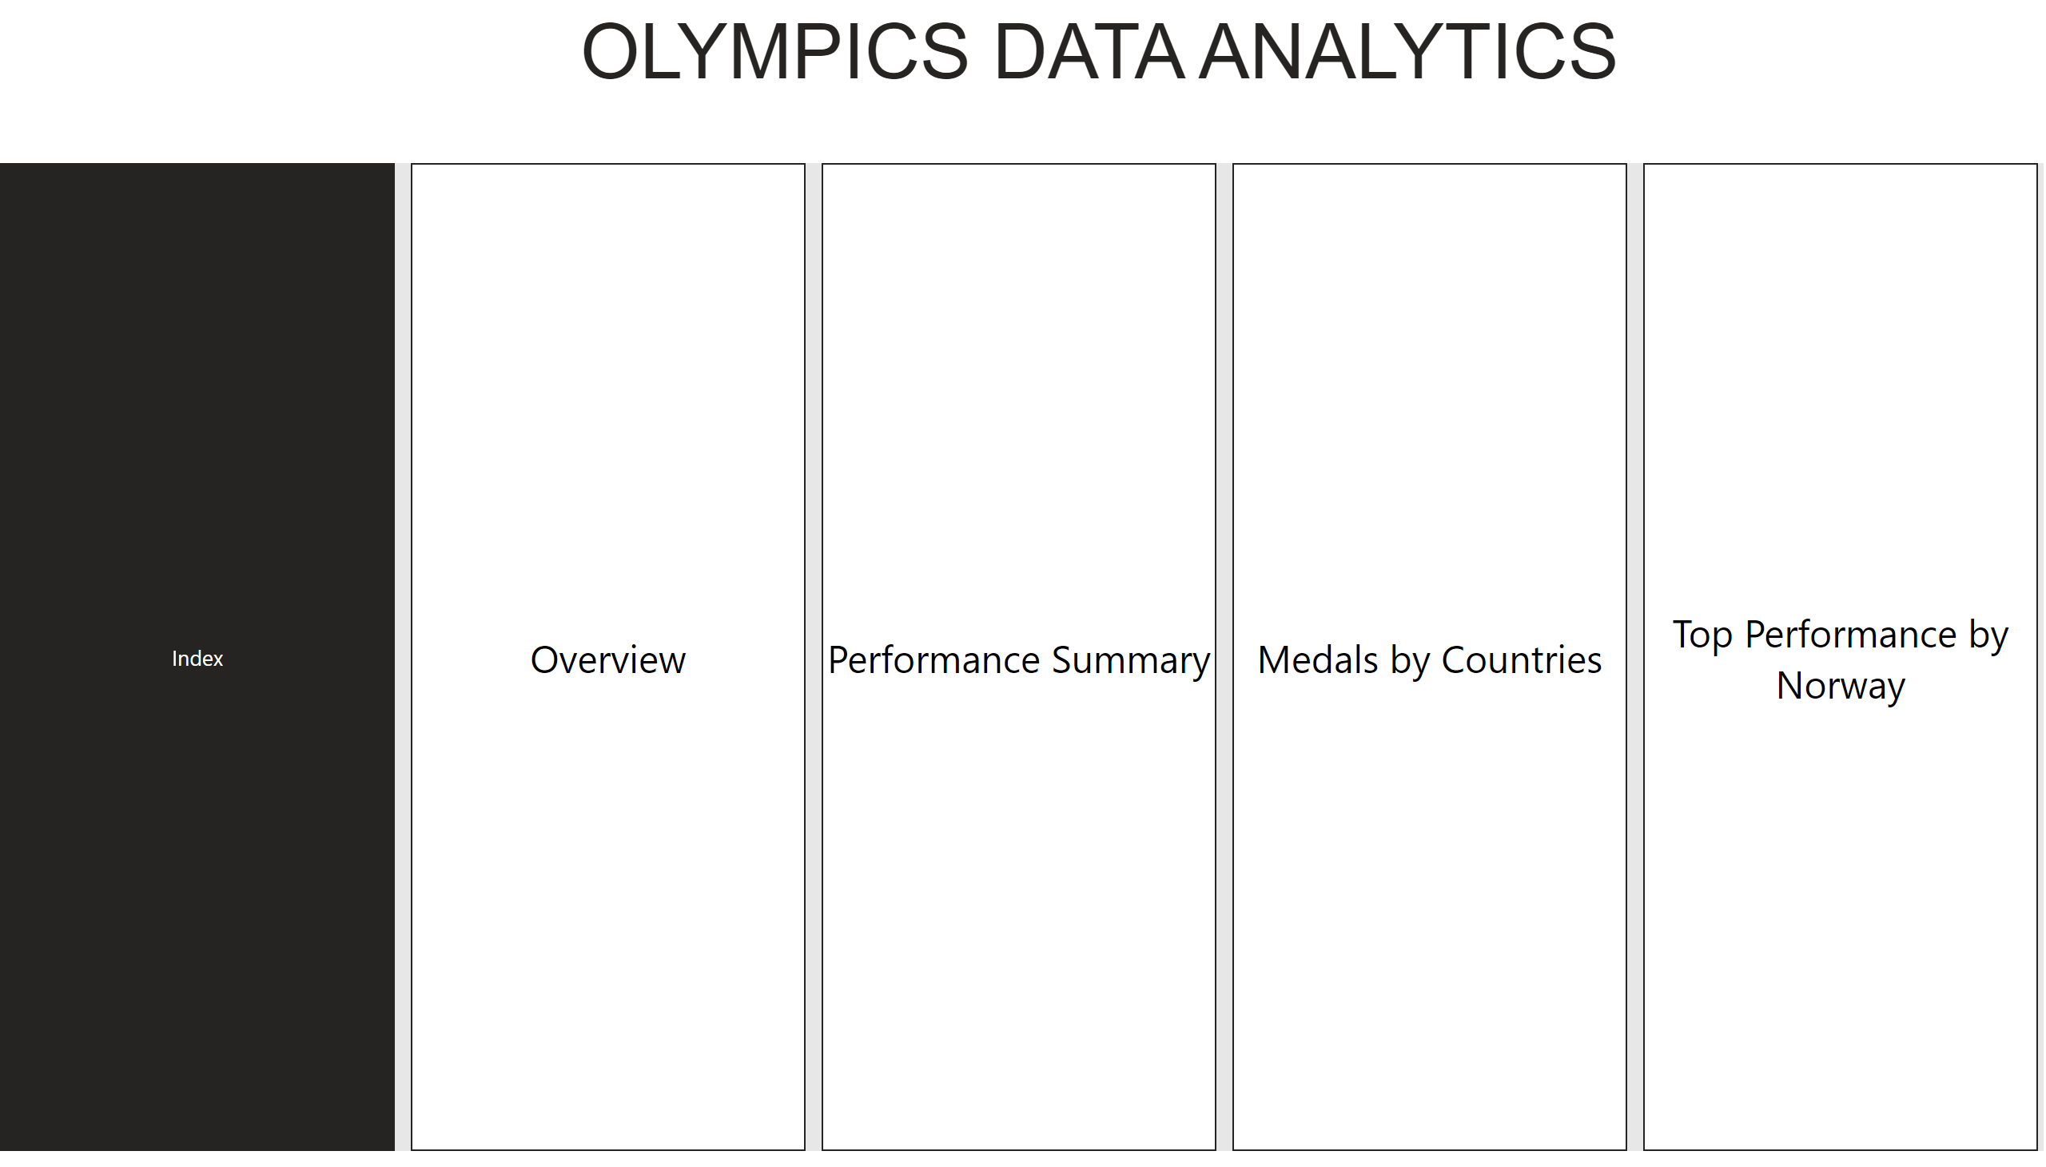
Index
Notes:
pageNavigator
No alt text provided
textbox
No alt text provided

Slide 3
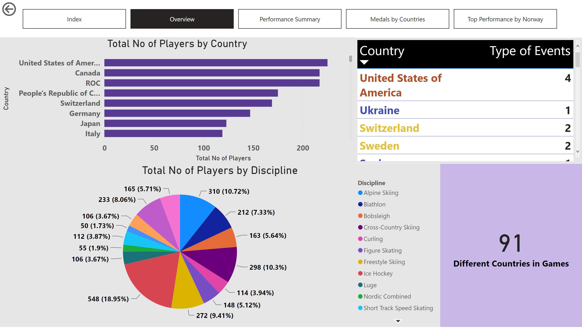
Overview
Notes:
tableEx
No alt text provided
pieChart
No alt text provided
barChart
No alt text provided
card
No alt text provided
actionButton
No alt text provided
pageNavigator
No alt text provided

Slide 4
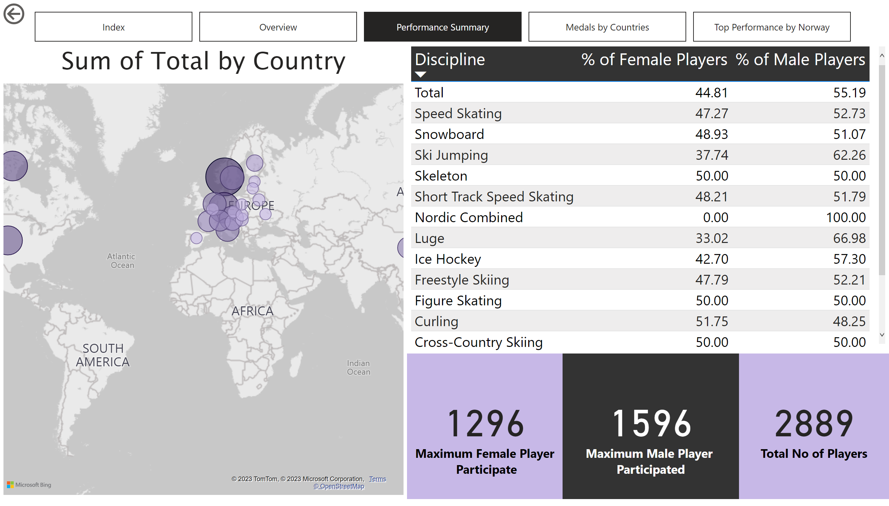
Performance Summary
Notes:
map
No alt text provided
tableEx
No alt text provided
actionButton
No alt text provided
card
No alt text provided
card
No alt text provided
card
No alt text provided
pageNavigator
No alt text provided

Slide 5
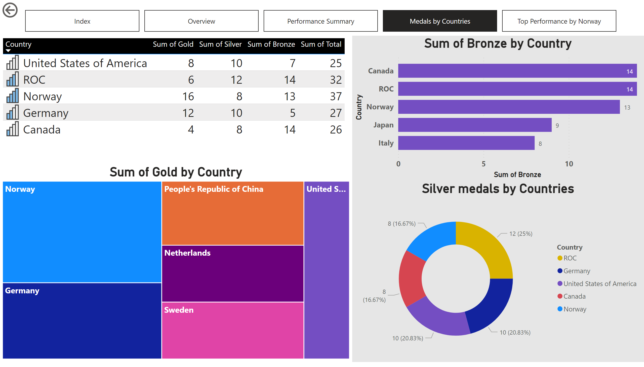
Medals by Countries
Notes:
tableEx
No alt text provided
Silver medals by Countries
No alt text provided
treemap
No alt text provided
barChart
No alt text provided
actionButton
No alt text provided
pageNavigator
No alt text provided

Slide 6
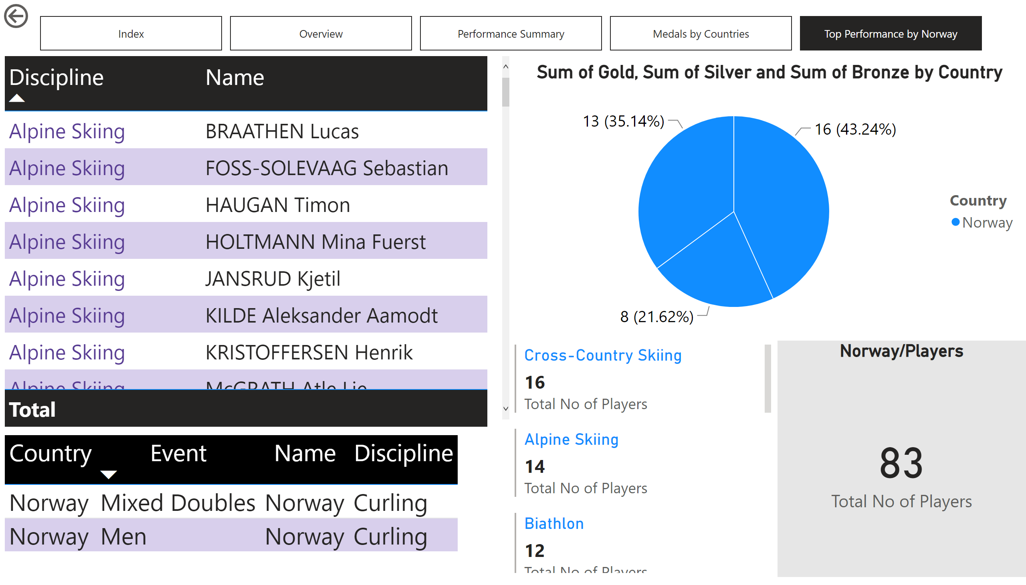
Top Performance by Norway
Notes:
pieChart
No alt text provided
Norway/Players
No alt text provided
tableEx
No alt text provided
multiRowCard
No alt text provided
tableEx
No alt text provided
actionButton
No alt text provided
pageNavigator
No alt text provided

